Slide 1

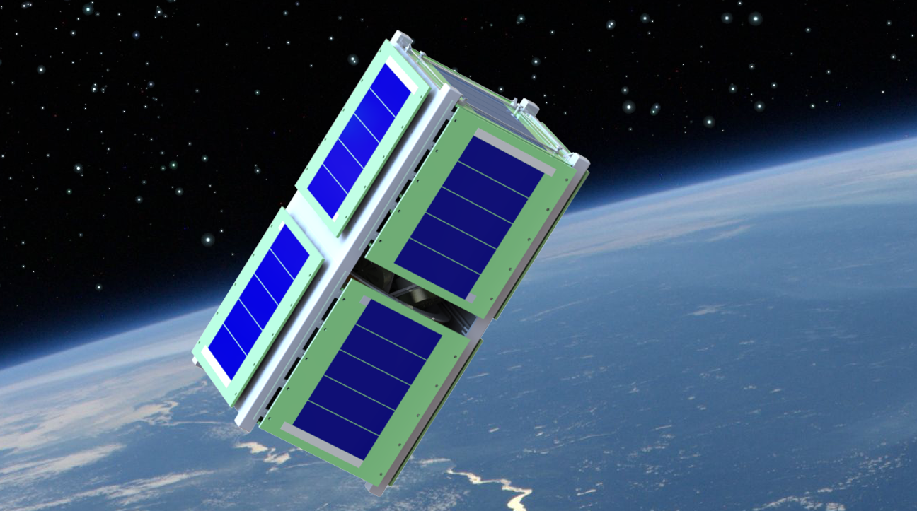
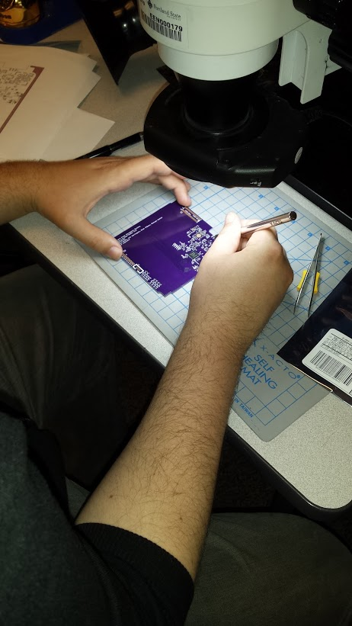
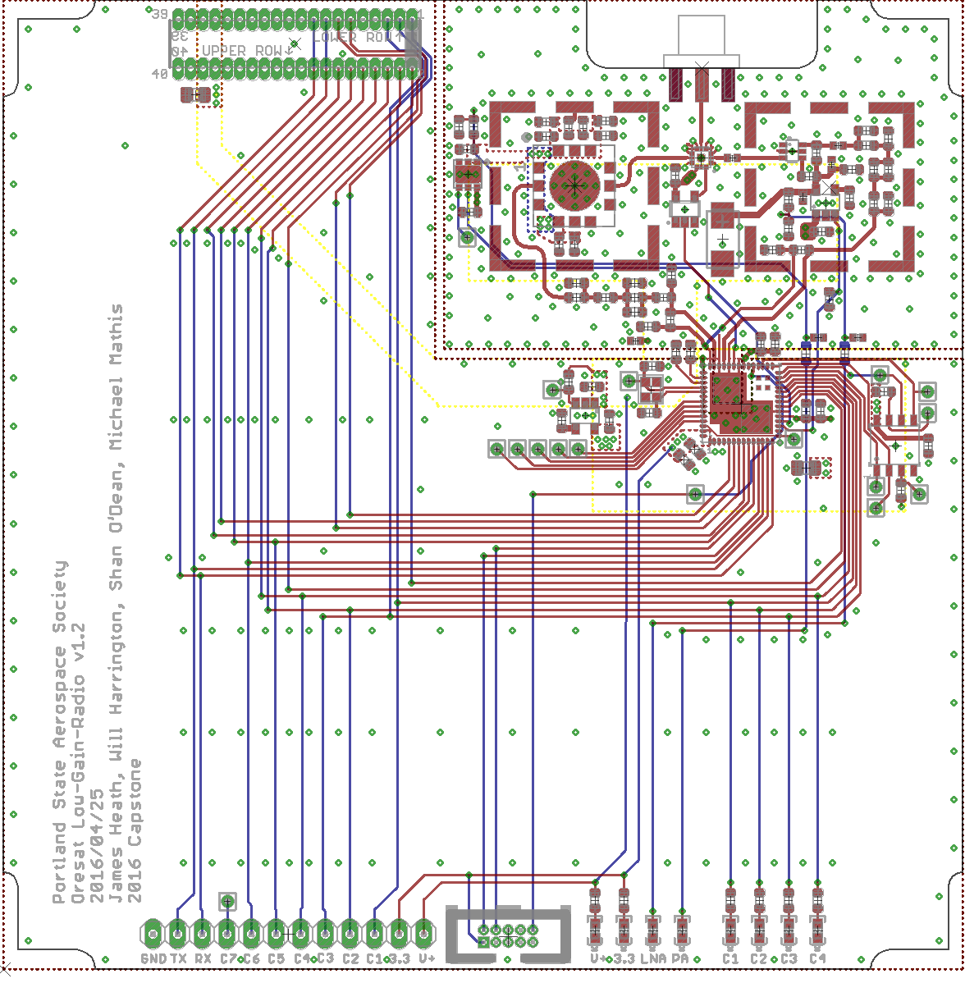
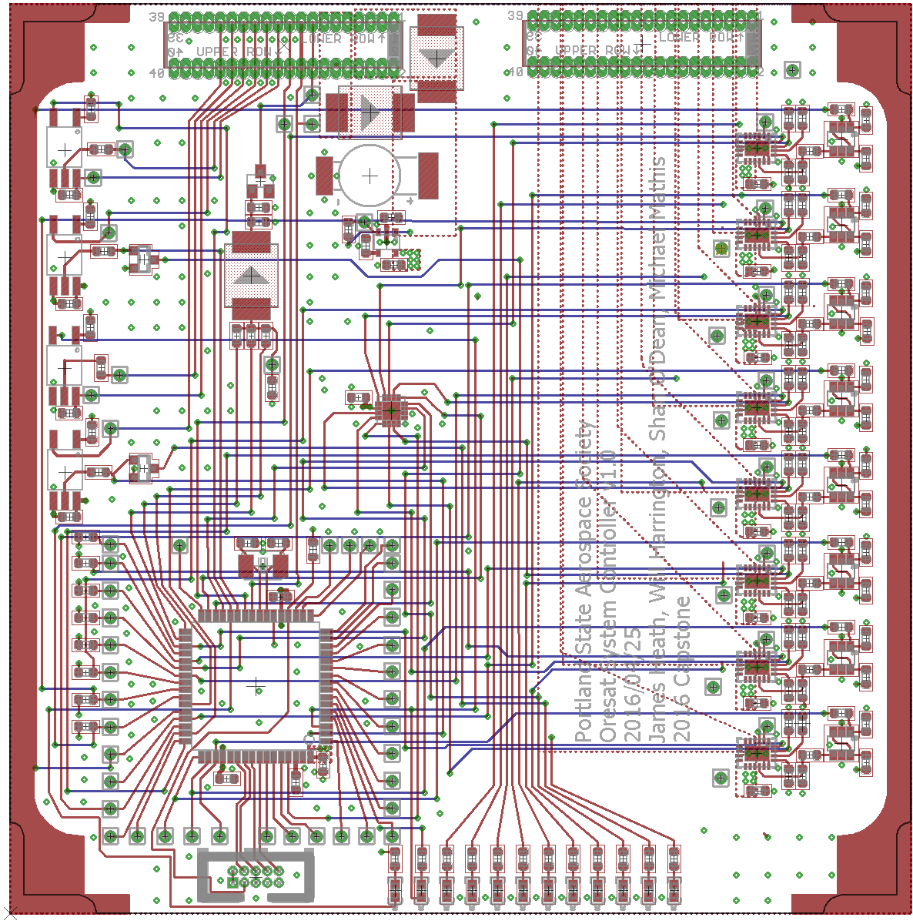
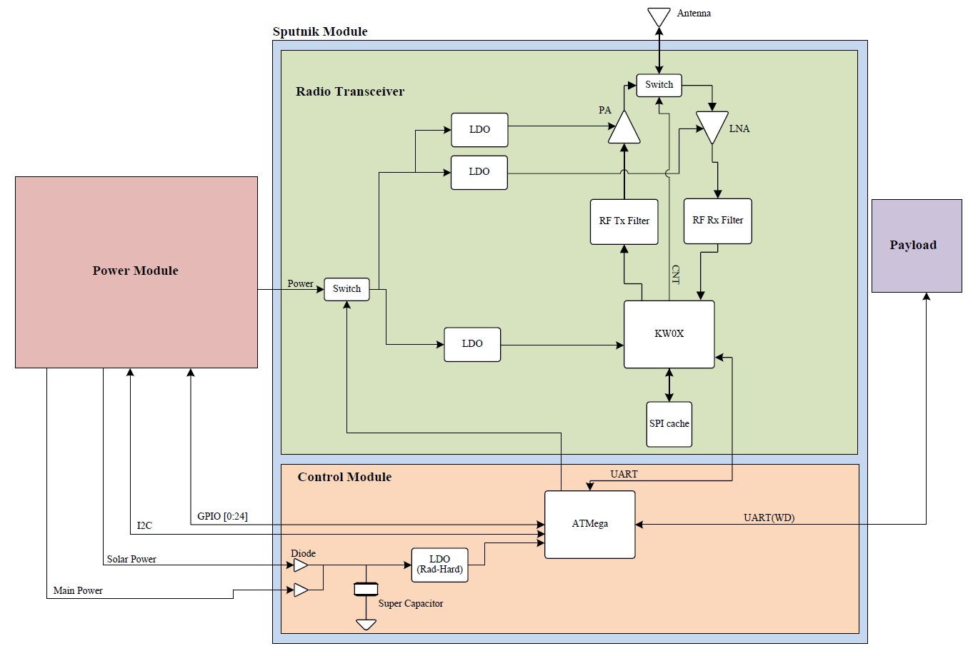
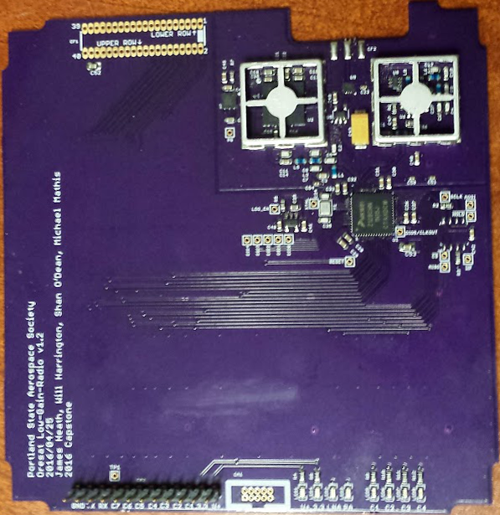

CubeSat Command Control
and Communications System
Project Team:
Will Harrington
Jake Heath
Michael Mathis
Shan Quinney
Special Thanks to:
Andrew Greenberg Theo
Glenn Dr. Teuscher
PSAS The LID
Introduction
Development
Results
PSAS is going to launch a small CubeSat satellite and they need a way to communicate with it. We were asked to make a system that can communicate and relay commands to and from a 400km orbit.
Block diagram of the Sputnik project
PSAS is going to launch a small CubeSat satellite and they need a way to communicate with it. We were asked to make a system that can communicate and relay commands to and from a 400km orbit.
Jake Heath working on an LGR module
The final board layouts for the LGR (left) and the SysCon (right)
Spectrum analyzer
screenshot
Picture of us doing
the 10km test
Design
Graph showing SOMETHING HARDWARY (left)
Picture of MEMBERS OF TEAM performing a 10km communications test (right)
Block diagram of the Sputnik project
Block diagram of the Sputnik project
Pictures of the finished boards LGR (left) and SysCon (right)
Department of Electrical and Computer Engineering

